Slide 1
Family Assessment Matrix (FAM)
What is it? Why do it?
Notes:
This is a short presentation about the Family Assessment Matrix, or FAM. We’ll talk about what it is and why we use it at Compass Family Services.

Slide 2
Why do we use the FAM?
The Family Assessment Matrix (FAM) is used to identify, understand, and show the impact that Compass Family Services has on the families it serves
Case Management: identify and document families’ needs at intake and along the way
Program Management: know how our programs are and aren’t supporting families effectively
Donor and Volunteer Communication: helps Compass communicate the many ways that programs support our clients
Notes:
The Family Assessment Matrix is a tool Compass uses to understand the impact our programs have on families. It’s important at three levels. First, at the individual client level, case managers can consistently understand and track a client’s stability. Second, at the program level program managers can see where we are impacting clients the most and least. Third, the information helps us communicate a more complete picture of the work we do to the community of donors, volunteers, and other organizations.

Slide 3
What does the FAM track?
The FAM tracks clients’ level of stability on 14 different categories. Note that key categories like Housing and Income are not tracked here because they are tracked outside of the FAM.
Credit
Domestic Violence
Mental Health
Substance Abuse
Support System & Community
Legal
Adult Education
Childcare
Child Education
Employment
Transportation
Accessing Health Services
Child Well-Being
CPS
Notes:
There are 14 categories represented in the FAM, listed here… You’ll notice key categories are not here, and that’s because they are being tracked in other ways outside of the FAM. For example, housing is tracked in the housing tracker and income is tracked in the income tracker. The FAM’s goal is to capture other things we miss when we focus only on housing and income.

Slide 4
How are we measuring clients’ stability?
Within each category, a family’s status may be anywhere from in-crisis to thriving, which is tracked on a 1 through 5 scale in the FAM. In some cases we may not be have enough information to know where a family is.
Crisis
1
Vulnerable
2
Self-Sufficient
4
Stable
3
Thriving
5
Also:
Not enough information at this time
Not Applicable / Ongoing Barrier
Notes:
Within each category, a family’s status may be anywhere from in-crisis to thriving, which is tracked on a 1 through 5 scale in the FAM. In some cases we may not be have enough information to know where a family is on this scale, in which case it would be “Not enough information at this time.” For example, at intake you may not know if a client has a Substance Abuse history and it may not be appropriate to ask, so we would mark that as not enough information. In certain categories, it may be that the scale is irrelevant to that particular family. For example, child education is not applicable if the family has no school age children. Or there may be a long-term barrier that will not be resolved at Compass. In the case of a felony conviction, there is an “Ongoing Barrier” for legal. Usually, in each category “N/A / Ongoing Barrier,” has a specific meaning or is not used.

Slide 5
When to do the FAM?
Adapt the FAM and its questions into your current intake and case management practices.
It’s not necessary for the FAM to require a FAM-specific session with a client because that could duplicate conversations you already have.
On the other hand, please work directly with your client to answer the FAM’s questions rather than assume based on old or incomplete information.
Frequency:
Intake
Every 90 days
Program Exit
Notes:
The Frequencies listed here are overarching Compass requirements but exactly when the assessment is used may vary by program. Intake means within 30 days of starting the program – the FAM doesn’t need to be immediately and will likely be easier after meeting your clients.
You can work the FAM into your current case management. It doesn’t have to be separate from normal conversations, but when completing the FAM make sure to be thorough and ask questions suggested in the Manual and cover all categories.

Slide 6

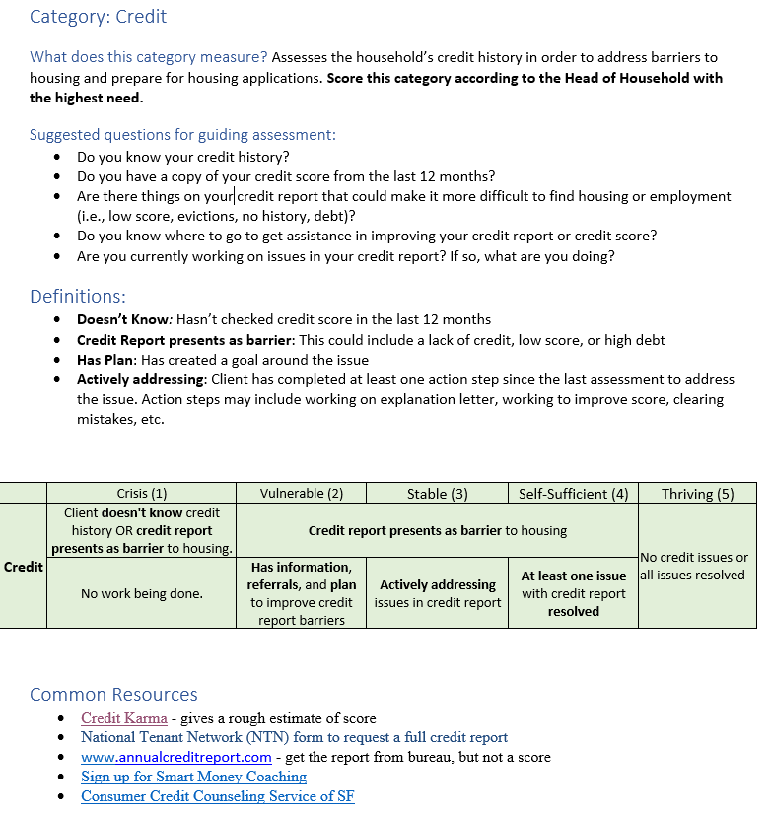
Tools: Manual
Notes:
The Manual is a very thorough guide to the categories and provides suggestions to structure conversations, and follow-up resources. Each category and common issues are covered. When you are new the FAM we recommend keeping the Manual on-hand.

Slide 7
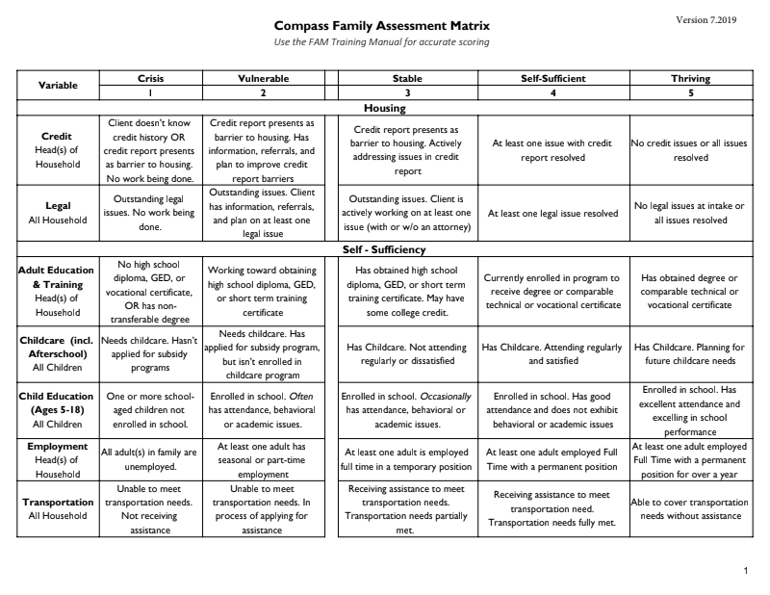
Tools: Matrix
Notes:
The “Matrix” is a shorthand version of the manual containing only the category scale definitions. Once you get more comfortable with the FAM, it can be your main tool and reference.

Slide 8
Note: Changes to the FAM
Due to issues with the original FAM, it was workshopped and significantly changed in 2018 and 2019:
What is New?
Reduced to 14 categories
New ‘How-To’ Manual
New look in CoDa
Clinical support for crisis in Well-Being categories
Notes:
This last bit is only relevant to staff who are familiar with the original, older FAM. Staff identified a number of issues with the old FAM so it was revamped in 2018 and 2019. Specifically, the categories were clarified – confusing categories were given simpler definitions, split into two if necessary, or removed if they were duplicative. The definitions were clarified and The Manual was created to answer the most common questions. Previously, several categories were unreliable (meaning the same staff might make different ratings of the same situation) and those have been tightened. Finally, some tweaks were made in Salesforce and Zendeskto make it easier to use.

